Slide 1
Chapter 18
Emotional and Social Development in Late Adulthood

Slide 2
THE GAME OF LIFE
1. You are now arranged into
color groups.
2. Throughout the PowerPoint you will notice colored squares at the bottom of each slide.
4. Then create a question to ask the rest of the class based on the information in the slide.
3. Find the slides that match your color.
Hint: Use the information you gleaned from the text as well as the summary slide to frame your question as it relates to that topic.

Slide 3
Create as many questions as you would like to capture the essential ideas you think others should think about when reflecting on your particular topic.
2 to 3 questions would be good.
Some variation in question type would be good too. You decide—there is not a right or wrong here—just working toward understanding.

Slide 4
Once all of your questions are created…
Let’s PLAY

Slide 5
1. Computers off.
2. Gather your group’s questions for each slide.
3. Let’s find out what we can learn from each other!

Slide 6
Erikson’s Theory: Ego Integrity vs. Despair
Despair
Feel many decisions were wrong, yet time is now too short
Bitter, unaccepting of death
Expressed as anger, contempt for others
Ego integrity
Feel whole, complete, satisfied with achievements
View life in context of all humanity
Associated with more favorable psychological well-being

Slide 7
Peck: Tasks of Ego Integrity
Ego differentiation:
affirm self-worth through family, friendship, community life
alternative to work-role preoccupation
Body transcendence:
emphasize cognitive, emotional, social powers
alternative to body preoccupation
Ego transcendence:
face reality of death constructively

Slide 8
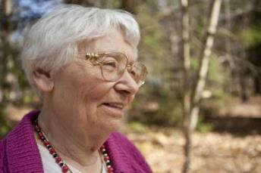
Joan Erikson: Gerotranscendence
Beyond ego integrity
Cosmic, transcendent perspective
Directed forward and outward, beyond self
Heightened inner calm, contentment
Quiet reflection
Notes:
8

Slide 9
Labouvie-Vief: Emotional Expertise
Decline in cognitive–affective complexity
Gain in affect optimization:
ability to maximize positive emotions, dampen negative ones
contributes to resilience
More vivid emotional perceptions:
expert at reflecting on own feelings
skillful use of emotion-centered coping

Slide 10
Reminiscence and Life Review
Life review
Form of reminiscence
Goal: greater self-understanding
Can lead to
increased self-esteem, sense of purpose
reduced depression
Reminiscence
Telling stories about the past:
Self-focused: can deepen despair
Other-focused: solidifies relationships
Knowledge-based: effective problem-solving strategies

Slide 11
Self-Concept and
Personality in Late Adulthood
Secure, multifaceted self-concept:
allows for self-acceptance
continued pursuit of possible selves
Resilience promotes adaptive functioning
Shifts in some personality characteristics:
gain in agreeableness
modest declines in extroversion
greater acceptance of change

Slide 12
The New Old Age
Third Age:
ages 65 to 79 and beyond
marked by personal fulfillment, self-realization, life satisfaction
more volunteer and service opportunities needed for aging adults
Fourth Age:
physical decline
need for care
© imtmphoto/Shutterstock
Notes:
12

Slide 13
Spirituality and Religiosity in Late Adulthood
Religion very important to majority of Americans age 65 and older
Late-life changes:
development of new faith capacities
openness to other religious perspectives
enlarged vision of common good
Religious involvement associated with
better physical, psychological well-being
closeness to family and friends
greater generativity

Slide 14
Factors in Psychological Well-Being
Control vs. dependency
Physical health
Negative life changes
Social support, interaction
Notes:
14

Slide 15
Control and Dependency in Late Adulthood
Dependency–support script: attend immediately to dependent behaviors
Independence–ignore script: ignore independent behaviors
Person–environment fit: match between person’s abilities and demands of living environments

Slide 16
Depression and Suicide
Increased suicide risk in older adults
Highest in white men age 70 and older
Factors:
losses: retirement, widowhood, social isolation
reduced physical functioning or pain
social isolation, lack of personal control
Effective treatment:
antidepressant medication plus therapy
help in coping with life transitions

Slide 17
Life Changes and Social
Support
Older people at high risk for negative life changes
Multiple negative changes test coping skills
Positive social support promotes physical health, psychological well-being
Important to take personal control of social support, maintaining control of highly valued activities

Slide 18
Social Theories of Aging
Disengagement theory | Mutual withdrawal between older adults and society
Activity theory | Social barriers cause declining rates of interaction
Continuity theory | Effort to maintain consistency between past and anticipated future
Socioemotional selectivity theory | Social networks become more selective with age, extending lifelong selection process Emphasis on emotion-regulating functions of social contact

Slide 19
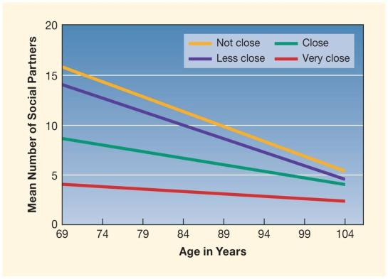
Age-Related Changes in Number of Social Partners
Figure 18.1
(From F. R. Lang, U. M. Staudinger, & L. L. Carstensen, 1998, “Perspectives on Socioemotional Selectivity in Late Life: How Personality and Social Context Do (and Do Not) Make a Difference,” Journal of Gerontology, 53B, p. 24. Copyright © 1998 The Gerontological Society of America. Adapted by permission of Oxford University Press and F. R. Lang.)
Notes:
Figure 18.1 Age-related changes in number of social partners varying in closeness

Slide 20
Social Contexts of Aging
Communities:
majority live in suburbs: higher income, better health
ethnic minorities in cities: better public transportation, social services
small town, rural: far from children; interaction with neighbors, friends
Neighborhoods:
preference for neighborhoods with other seniors
Housing: preference for aging in place

Slide 21
Housing Arrangements in Late Adulthood
Ordinary homes
Living in own home: greatest personal control
Living with family members
Living alone: number increasing
Residential communities
Congregate housing
Life-care communities
Nursing homes
Restrict autonomy, social integration
Green House model: effective person–environment fit
Notes:
21

Slide 22
Marriage in Late
Adulthood
Satisfaction peaks:
fewer stressful responsibilities
greater fairness in household tasks
joint leisure
greater emotional understanding, regulation
Marital dissatisfaction harder for women
Notes:
22

Slide 23
Long-Term Gay and Lesbian Partnerships
Most report happy, highly fulfilling relationships
Healthier, happier than those who live alone
Experiencing oppression may have strengthened skill for coping with late-life changes
Still face legal, health-care issues

Slide 24
Divorce, Remarriage, and Cohabitation
Divorce | Few divorces in late adulthood, but rate is increasing Hard to recover, especially for women
Remarriage | Rates low, decline with age Higher for divorced than widowed Late remarriages are stable
Cohabitation | Growing trend as baby boomers age Relationships more stable than at younger ages

Slide 25
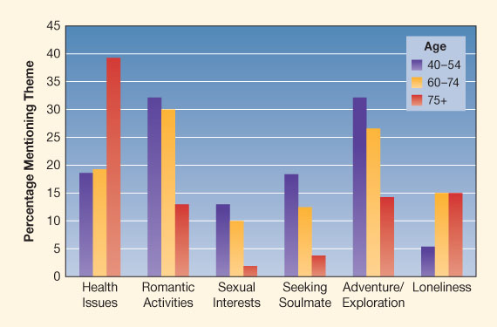
Older Adults’ Online Personal Ads
Figure 18.2
(From S. S. R. Alterovitz and G. A. Mendelsohn, 2013, “Relationship Goals of Middle-Aged, Young–Old, and Old–Old Internet Daters: An Analysis of Online Personal Ads.” Journal of Aging Studies, 27, p. 163. Copyright © 2013, Elsevier. Reprinted by permission of Elsevier, Inc.)
Notes:
Figure 18.2 Themes in online personal ads of middle-aged and older adults seeking dating partners

Slide 26
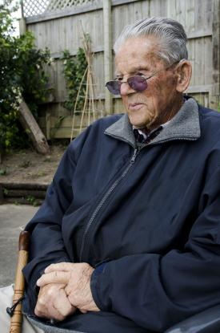
Widowhood
Most stressful life event for many
One-third of older adults are widowed
Most live alone, cope with loneliness
Reorganizing life harder for men:
more physical, mental health problems
more likely than women to remarry
© ChameleonsEye/Shutterstock

Slide 27
Fostering Adaption to Widowhood in Late Adulthood
Self: mastery of new skills of daily living
Family and friends: social support, interaction
Community:
senior centers
support groups
religious activities
volunteer activities
Notes:
27

Slide 28
Never-Married, Childless Older Adults
About 5% of older Americans
Most develop alternative meaningful relationships:
extended family
neighbors
younger people
Men more likely to be lonely, depressed
Notes:
28

Slide 29
Friendships in Late
Adulthood
Friends provide
intimacy, companionship
acceptance
link to community
help with loss
Feel closest to a few nearby friends
Choose friends similar to self in age, sex, ethnicity, values
Sex differences continue
Notes:
29

Slide 30
Relationships with Adult Children
Quality of relationship affects older adults’ physical, mental health
Provision of assistance:
balance changes, with children helping more as parents age
SES affects balance of support
most aid is emotional support, not practical assistance

Slide 31
Elder Maltreatment
Physical abuse
Physical neglect
Emotional abuse
Sexual abuse
Financial abuse
Notes:
31

Slide 32
Risk Factors for Elder Maltreatment
Dependency of victim
Dependency of perpetrator: emotional or financial
Psychological disturbance and stress of perpetrator
History of family violence
Institutional conditions: more common in low-quality nursing homes

Slide 33
Decision to Retire
Continue working
Limited or no benefits
Few leisure interests
High work commitment
Good health
Spouse working
Flexible work schedule
Pleasant, stimulating work
Retire
Adequate retirement benefits
Compelling leisure interests
Low work commitment
Declining health
Spouse retiring
Routine, boring job

Slide 34
Adjusting to Retirement
Most people adapt well
10–30% report some adjustment difficulties
Factors in adjustment:
workplace factors
financial worries
spouse influence
sense of personal control
social support
Notes:
34

Slide 35
Leisure and Volunteer Activities
Interests usually continue from earlier in life:
choose meaningful, personally gratifying pursuits
frequency and variety decline with age
Rewarding leisure activities linked to better health, reduced mortality:
self-expression
new achievements
helping others
social interactions
Notes:
35

Slide 36
Optimal Aging
Minimize losses, maximize gains
Less focus on specific achievements, more on processes for reaching personal goals
Greater influence of controllable factors in well-being
Social policies can help
Notes:
36

