Slide 1
Chapter 19
Death, Dying, and Bereavement

Slide 2
Phases of Dying
Agonal phase
Gasps and muscle spasms during first moments in which regular heartbeat disintegrates
Clinical death
Interval in which heartbeat, circulation, breathing, brain functioning stop, but resuscitation still possible
Mortality
Permanent death

Slide 3
Defining Death
Brain death | irreversible cessation of all activity in brain and brain stem standard for death in most industrialized nations
Persistent vegetative state | cerebral cortex no longer registers electrical activity brain stem remains active

Slide 4
Death with Dignity
Integrity of person’s life is fostered by the quality of communication with and care for dying person:
assurance of support
compassionate care
esteem and respect
candidness about death’s certainty
information to make reasoned end-of-life choices

Slide 5
Death Anxiety
Cultural variations
influenced by religious teachings
for Westerners, spirituality, meaning of life more important than religious commitment
Individual variations
women more anxious than men
low among adults with deep faith in higher being
reduced by sense of symbolic immortality

Slide 6
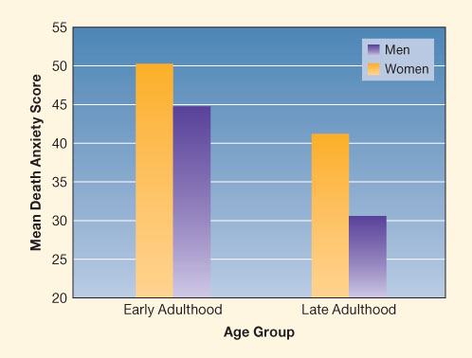
Age, Gender, and Death Anxiety
Figure 19.1
(Adapted from Tomer, Eliason, & Smith, 2000.)
Notes:
Figure 19.1 Relationship of age and gender to death anxiety

Slide 7
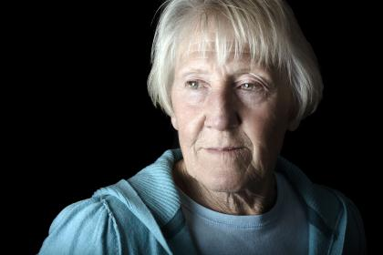
Kübler-Ross’s Theory
Denial
Anger
Bargaining
Depression
Acceptance
Notes:
7

Slide 8
Evaluating Kübler-Ross
Stages are not a fixed sequence, not universal
Does not allow for context
May lead to caregiver insensitivity
Best seen as coping strategies
Notes:
8

Slide 9
Appropriate Death
Makes sense in terms of person’s pattern of living, values
Preserves or restores significant relationships
As free of suffering as possible
Also includes
achieving a sense of control
confronting and preparing for death

Slide 10
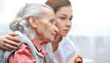
Factors That Influence Thoughts About Dying
Nature and course of illness
Personality and coping style
Behavior of family members and health professionals
Spirituality, religion, culture

Slide 11
Traditional Places of Death
Home:
most preferred option: intimacy, loving care
only about 25% die at home
need for adequate caregiver support
Hospital:
intensive care unit can be depersonalizing
comprehensive treatment programs optimal
Nursing home:
focus usually not on terminal care
improves greatly when combined with hospice care

Slide 12
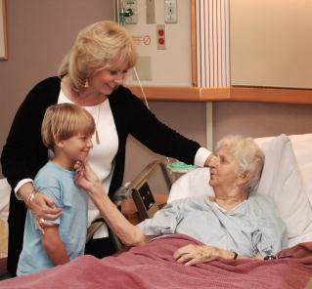
Hospice Approach
Comprehensive program of support for dying and their families:
patient and family as unit of care
interdisciplinary team
palliative (comfort) care
home or homelike setting
bereavement services
Notes:
12

Slide 13
Forms of Euthanasia
Passive | withdrawal of treatment advance medical directive: living will, durable power of attorney
Voluntary active | medical staff or others act to end life at patient’s request
Assisted suicide | medical staff provide means for patient to end own life remains controversial
Involuntary active | medical staff end life without patient’s consent

Slide 14
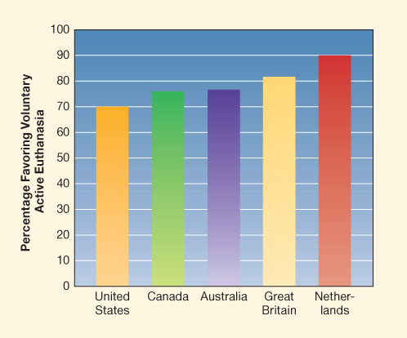
International Public Opinion on Voluntary Active Euthanasia
Figure 19.2
(From Harris Interactive, 2011; Pew Research Center, 2006.)
Notes:
Figure 19.2 Public opinion favoring voluntary active euthanasia in five nations

Slide 15
Advance Medical Directives
Written statement of desired medical treatment in case of incurable illness
Living will: specifies desired treatments
Durable power of attorney:
authorizes another person to make health-care decisions on one’s behalf
more flexible than living will
can ensure partner’s role in decision making even in relationships not sanctioned by law

Slide 16
Assisted Suicide
Doctor provides drugs for patient to use
Legal in few nations, tacitly accepted in many
Legal in only four U.S. states
Few choose this option
Highly controversial:
opposed by many, including AMA
some find option comforting

Slide 17
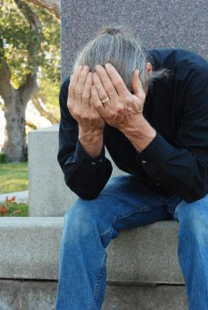
Grief Process
Avoidance
“emotional anesthesia”
Confrontation
most intense grief
Restoration
dual-process model of coping with loss
alternate between dealing with emotions and with life changes
Notes:
17

Slide 18
Grieving Sudden or Prolonged Deaths
Sudden, unanticipated
Avoidance from shock and disbelief
Survivor may not understand reasons
Suicide especially hard to bear
Prolonged, expected
Anticipatory grieving: allows emotional preparation
Reasons for death usually known

Slide 19
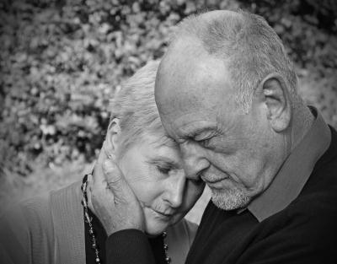
Difficult Grief Situations
Parents losing a child
Children or adolescents losing a parent or sibling
Adults losing an intimate partner
Bereavement overload
Notes:
19

Slide 20
Bereavement Interventions
General support | sympathy, understanding patient listening, “being there”
Interventions | support groups help with reorganizing daily life
Children and adolescents | after violent death, prevent unnecessary reexposure
Difficult situations | sudden, violent, unexplainable, or ambiguous deaths grief therapy, individual counseling

Slide 21
Resolving Grief
Give yourself permission to feel loss.
Accept social support.
Be realistic about course of grieving.
Remember the deceased.
When ready, invest in new activities and relationships.
Master new tasks of daily living.

Slide 22
Death Education
Courses in death and dying offered at many educational levels
Lecture format: imparts knowledge but may increase discomfort
Experiential format:
role playing, discussions, guests, field trips
may reduce death anxiety

Slide 23
Goals of Death Education
Increase understanding of physical, psychological changes in dying
Help students learn to cope with death of loved ones
Prepare informed consumers of medical, funeral services
Promote understanding of social, ethical issues

